Slide 1
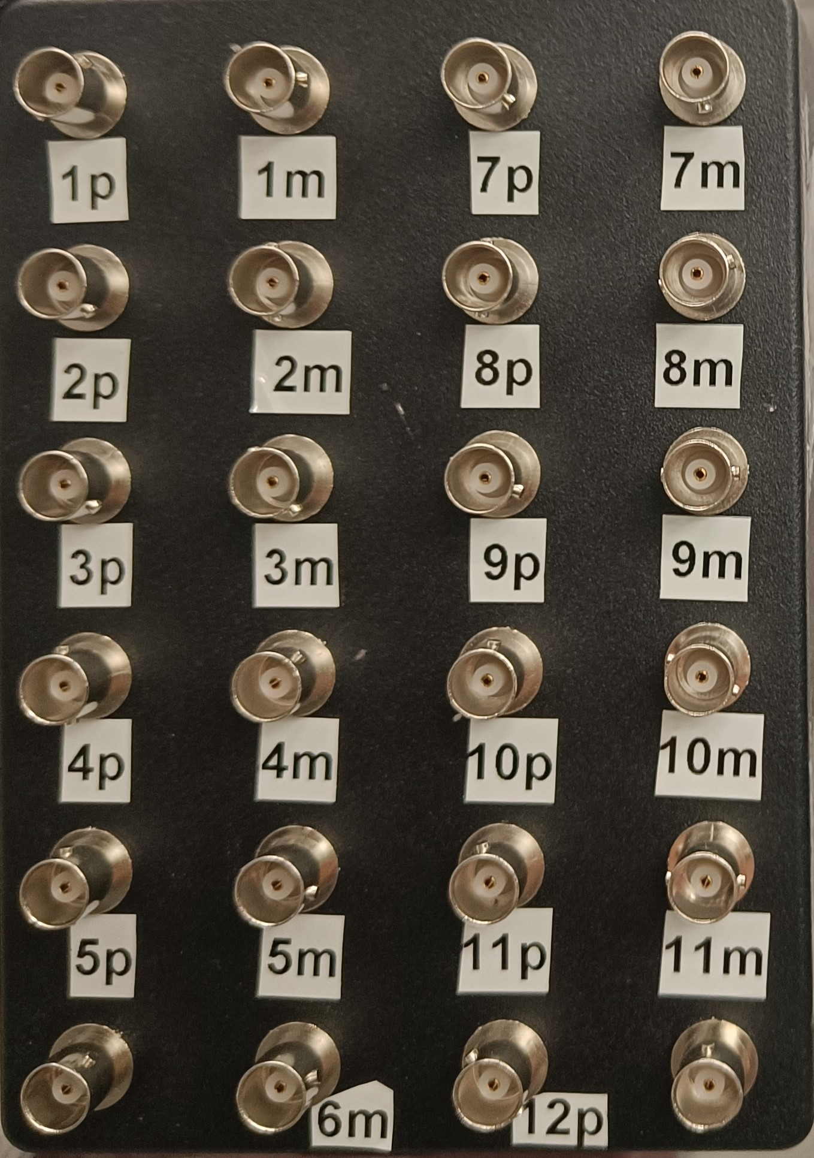
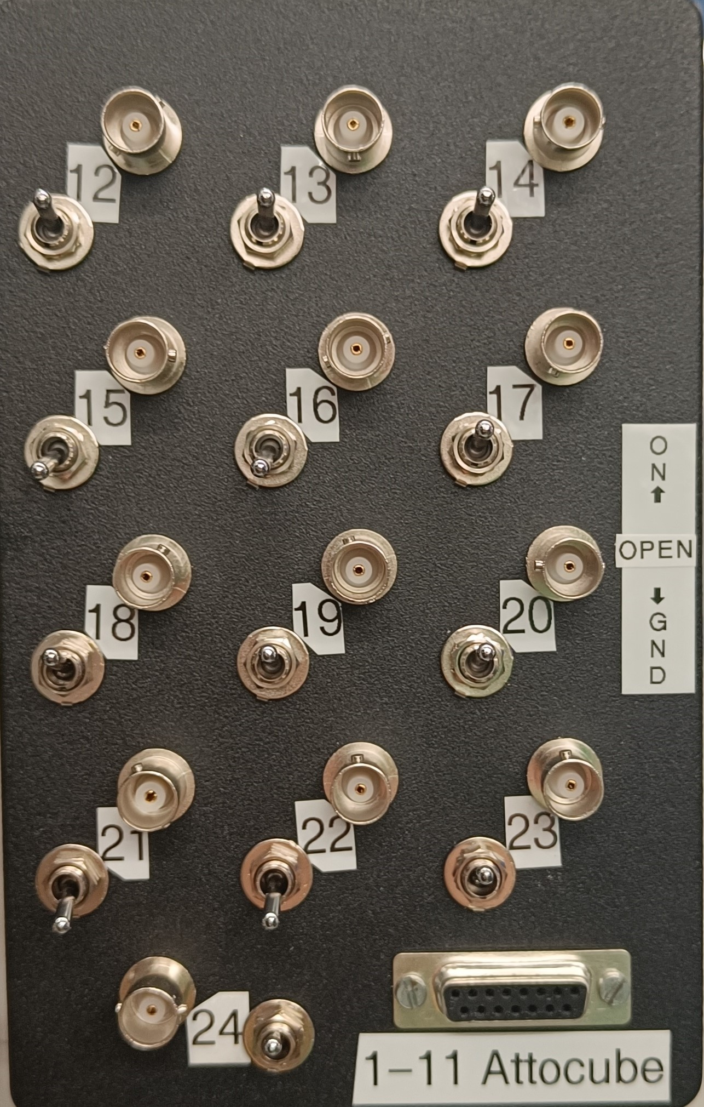
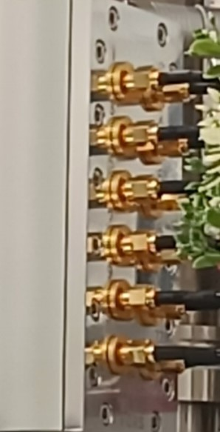
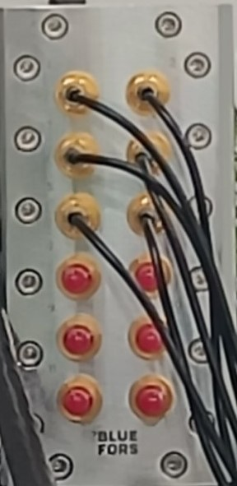
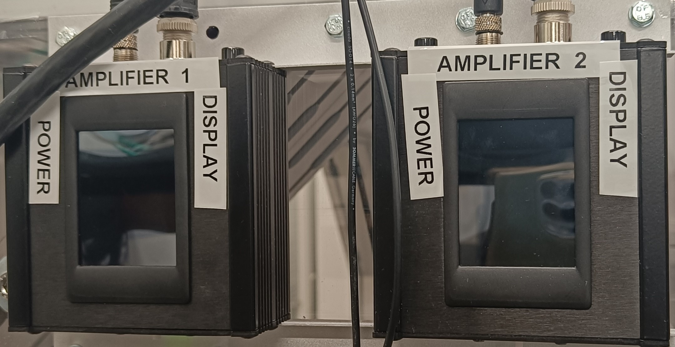
Resistive
12 tw. p.
Resistive
12 tw. p.
Low R
12 tw. p.
Attocube
lines
Thermocoax
12 lines
Low F coax.
6 lines
Power lines
for 4 LNAs 2 power supplies
Optofiber
Line x 2
LNA1 LNA2 LNA3
1 2
3 4 5 6 7 8 9 10 13 14 15 12 16 17
RT
50K
4K
STILL
CP
MXC
6
6
3
6
3
3
6
3
6
3
3
6
6
6
4-8 4-8
1
2
10
10
10
20
20
20
20
10
10
20
20
12
12
12
6
6
0
6
0
0
6
0
6
0
0
6
6
6
20
20
20
0
0
0
0
20
20
0
0
20
20
20
12x2 (1-24)
25pin cinch
12x2 (1-24)
25pin cinch
12x2 (1-24)
25pin cinch
Attocube
connections
Optofiber
Line x 2
Thermocoax
12 lines
Low F coax. 6 lines
20
20
20
0
0
0
0
20
20
0
0
20
20
20

